Slide 1

Triibe
Connect With Your Friends Inside
The University On Triibe .

Slide 2
Team Members & Supervisors
Team members:
Radwan Susan
Zaid Al-Tamari
Omar Thaer
Doaa Abd Aljbar
Hamza Khatari
Supervisor:
Prof. Dr. Malek Alksasbeh

Slide 3
Table of contents
01
Introduction
02
Literature review
Problem statement
Goal & Aim of the project
Research on the topic
Comparison table
03
Methodology
04
Analysis and design
Waterfall method
Requirement analysis
Design Diagrams
05
Findings
06
Observe and evaluate
Implementation & Review
Black & White box Testing
07
Conclusion
Conclusion & limitations
Future work

Slide 4
01
Introduction

Slide 5
Introduction
Introduction
Social media websites lately have been growing and expanding in the number of daily users. This helps people reach each other easily and more efficiently.
Triibe is a social media platform for students inside their universities that helps students communicate easily and has academic-focused functionalities to help students achieve their goals.
In the scope of universities and academic facilities, students use public social media. Websites that are used by the public, which can sometimes be unsecured and unhelpful.
On the management side, the university will have full access to all the management functionalities of the website to manage the website.

Slide 6
Problem Statement
If social networking services were not available, people would encounter plenty of problems in their personal and professional lives. Social networking, as we all know, was developed to make social communication easier.
Despite the fact that recent technological breakthroughs have reduced barriers between people, social life among students within their universities can be chaotic and confusing.
Triibe overcomes this challenge by bringing together university students on one website, allowing students to communicate easily and quickly, teachers to reach out to their students, and the university as a whole to benefit.

Slide 7
Project Objectives
The main objective of this project is to develop a centralized system that enables students to communicate and promote their belongings within the university. Not only does the system allow promotion, but it also provides information sharing and data transmission.
The main objectives of the project:
Reach your audience by posting on your profile or to the public.
Texting with students or teachers.
Sharing files, images, or videos with others.
Sharing your location with your students and with individuals.
Accessing learning resources easier and faster.
List your belongings for sale on the website's integrated market.
Get some registration guidance.
Communicate with your colleagues that are in the same subject with premade groups.
Get some university navigation guidance with the onboard university map.

Slide 8
Project Significance
Triibe can help students, and teachers effortlessly connect with one another as well as share data, photos, and videos within the platform. "Triibe" solves the problem of students having to use many social networking sites to interact and accomplish their goals, making the process more efficient and successful for them. Teachers can also benefit from “Triibe” by using groups inside the platform to spread the message to students.
Students and instructors can also remain in touch with former friends and colleagues by using “Triibe”.

Slide 9
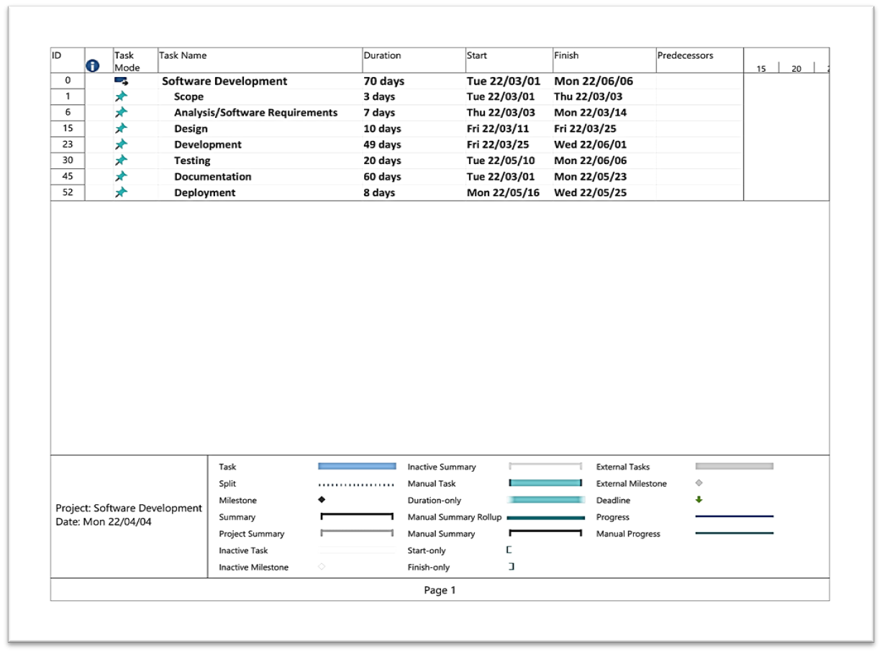
Gantt Chart

Slide 10
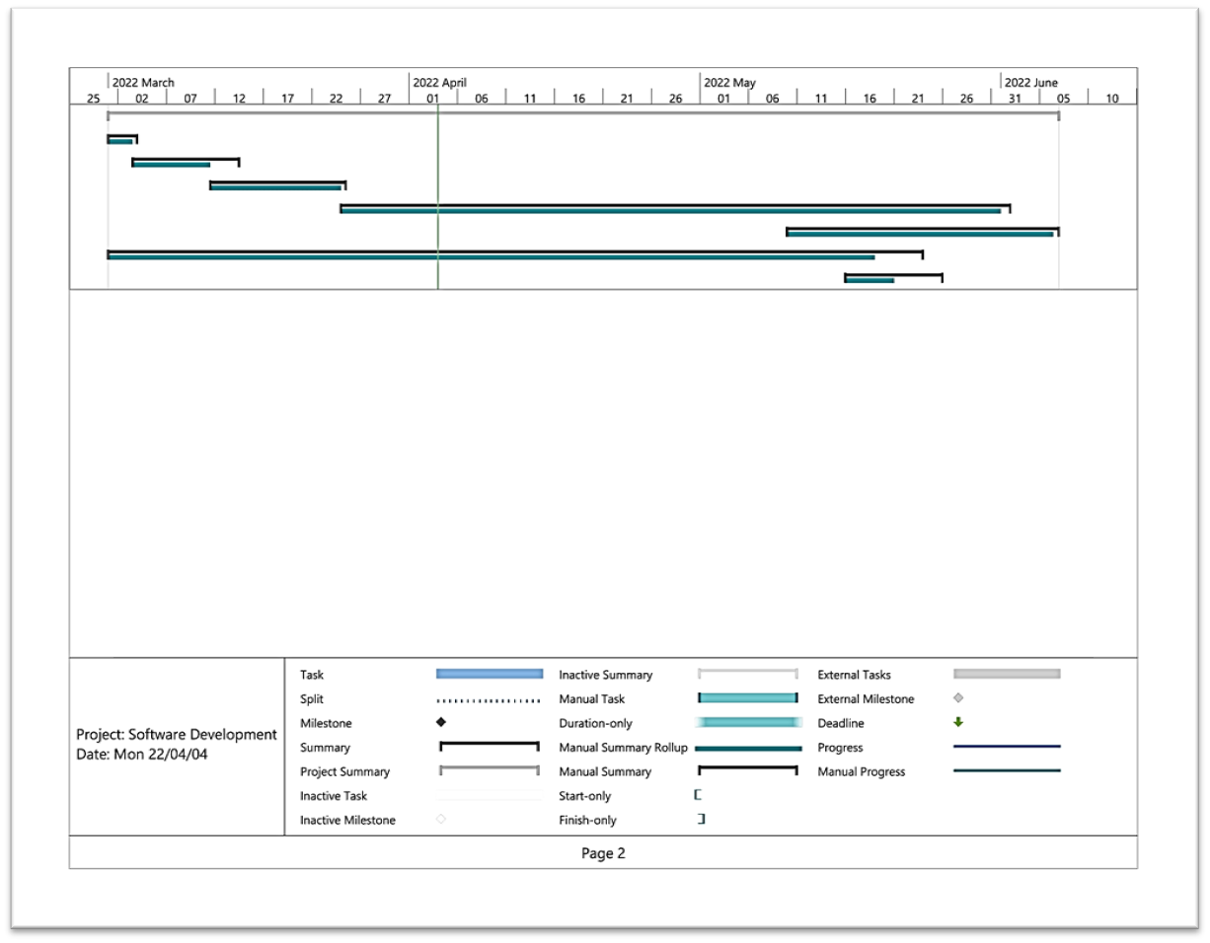
Gantt Chart

Slide 11
Literature review
02

Slide 12
Social Media Platforms
Platforms
Triibe
Facebook
Instagram
Twitter

Slide 13
Comparison Table

Slide 14
03
Methodology

Slide 15
Waterfall Methodology
The waterfall approach often referred to as the waterfall methodology, is a consecutive development process that flows like a waterfall through all phases of a project, such as analysis, designing, implementation, and validation, with each step completed before moving on to the next.
The waterfall method's success is determined by the quantity and quality of work done on the front end, which includes documenting everything ahead of time, including the user interface, user stories, and all feature changes and outcomes. Because the bulk of the research is done ahead of time, estimations of the time required for each need are more accurate

Slide 16
Waterfall Methodology phases
Requirements
Design
Implementation
Verification and testing
Deployment and maintenance

Slide 17
04
Analysis and design

Slide 18
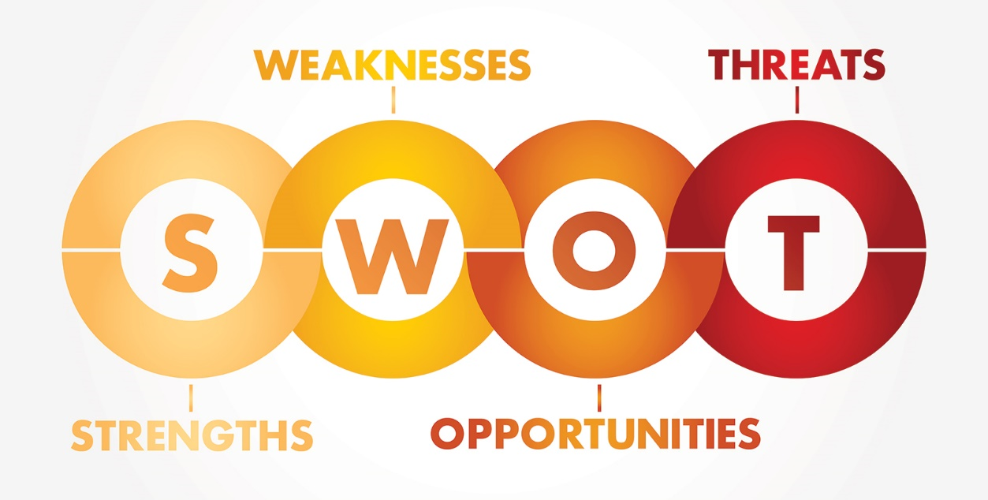
Triibe Analysis
SWOT Analysis:
"A SWOT analysis (alternatively SWOT matrix) is a structured planning method used to evaluate the strengths, weaknesses, opportunities, and threats involved in a project or a business venture”

Slide 19
Triibe Analysis
SWOT Analysis:
Strength:
There are so few websites focused on the communication between students within the university campus.
Allows integration with many other websites that help the student.
The usability is wonderful.
Recognizes and anticipates the needs and desires of users.
Weakness:
Some functionality, such as video chats and group conversations, is missing.
Information about users is not well protected.
A poor image is created by beliefs regarding consumers' privacy.

Slide 20
Triibe Analysis
SWOT Analysis:
Opportunities:
The number of people using smart devices to access social media is growing.
Expansion to other learning platforms, such as schools and colleges.
Threats:
Privacy issues like identity theft.
Social media websites that aren’t limited to specific facilities, such as Facebook and Instagram.
Some users refuse to use social media platforms and prefer to live an anti-social lifestyle.
Some users don’t have smart devices to access the platform.

Slide 21
Triibe Analysis
Functional Requirements:
Search: the ability to search for users and groups within the website.
Personal account: the student can log in with a username and a password to control his/her personal account and interact with the pages, groups, and friends that he views.
Profile: the user will be able to see all of his profile information from the different networks on one page divided by tabs.
Publishing:
1) Add your own content.
2) Edit and remove your content
3) Comment, share and add likes
Sharing stories: A story can be added by the student to his/her account to be seen by the student’s colleagues.
Groups and pages: Allow students to communicate directly with one another and manage pages.
Market: Allow students to sell their products in the community for a profit.

Slide 22
Triibe Analysis
Non-Functional Requirements:
Safety & Security: The passwords of the users of the website will be encrypted and saved on a decentralized database.
Portability: The system should operate on any OS that has an internet browser and an internet connection.
Performance: The system should operate on low-end computers easily.
Maintainability: The system should be maintained with ease.

Slide 23
Triibe Analysis
System's Requirements:
Our project requires an internet browser to access the website.
Our project must be able to work in different environments of operating systems.
The user must be able to come out of the website at any time he wants.
Our project requires a stable internet connection.

Slide 24
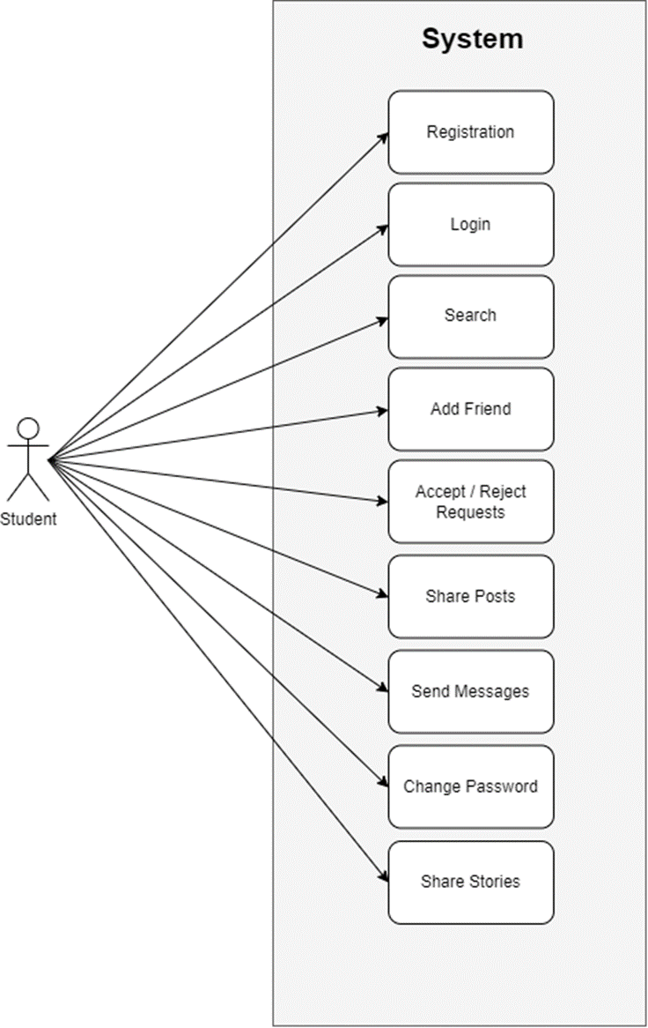
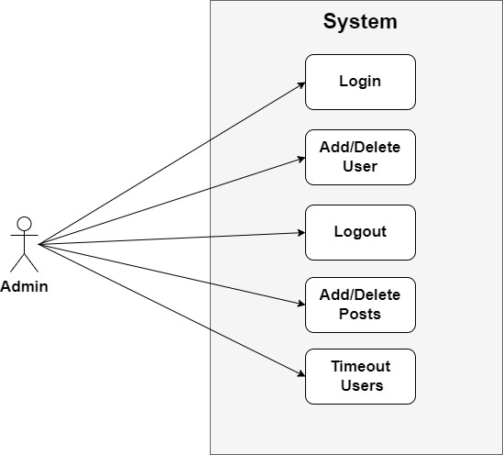
Triibe Design
Student & Admin Use-case Diagram:

Slide 25
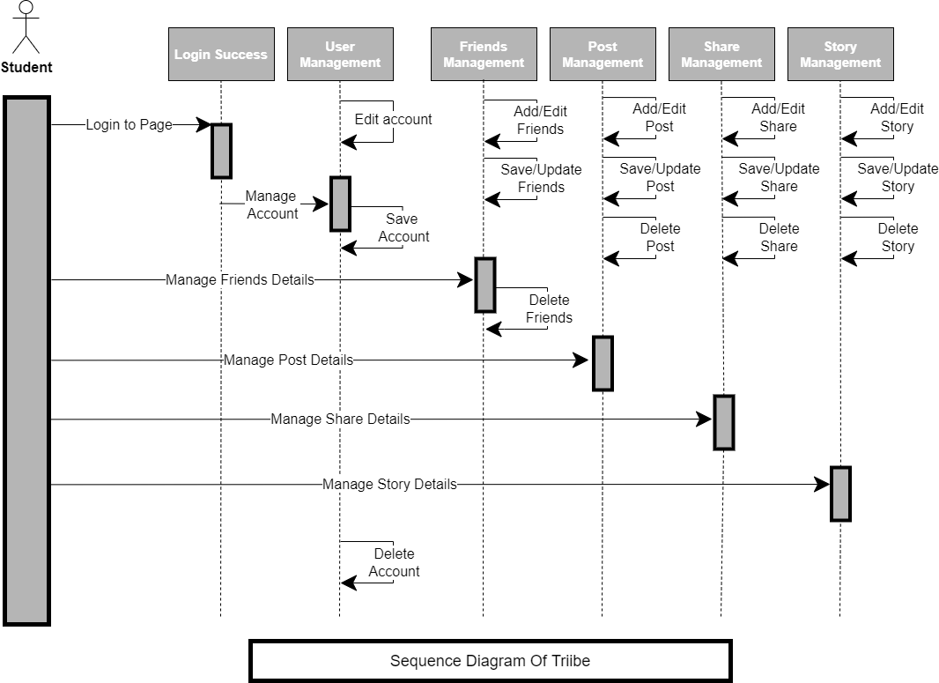
Triibe Design
Student Sequence Diagram:

Slide 26
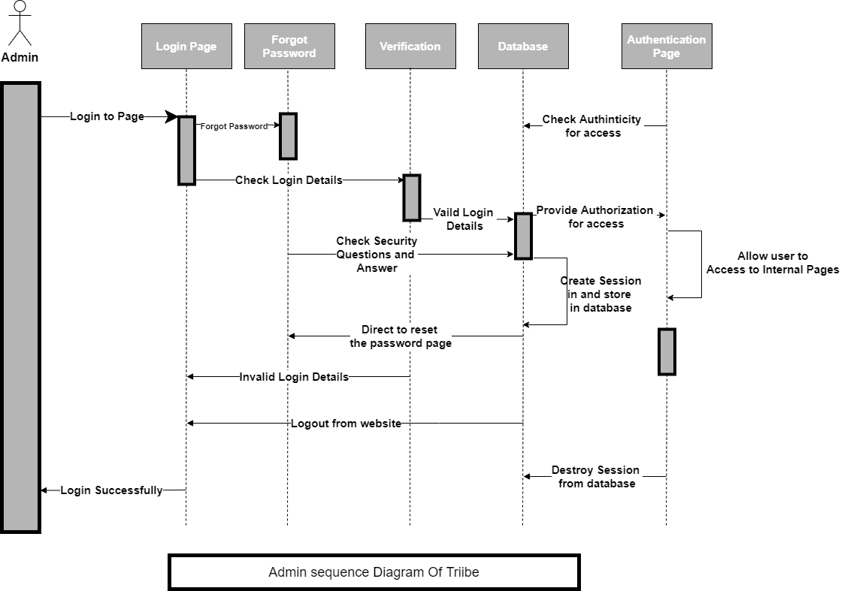
Triibe Design
Admin Sequence Diagram:

Slide 27
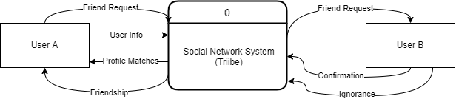
Triibe Design
Context Diagram:

Slide 28
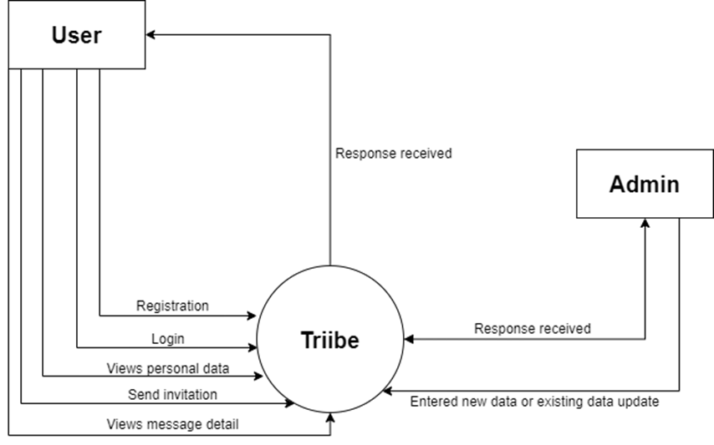
Triibe Design
Level 0 Data Flow Diagram:

Slide 29
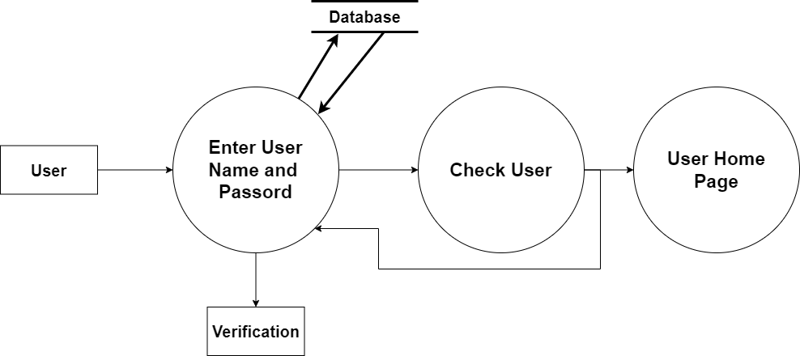
Triibe Design
Level 1 Data Flow Diagram (Log in):

Slide 30
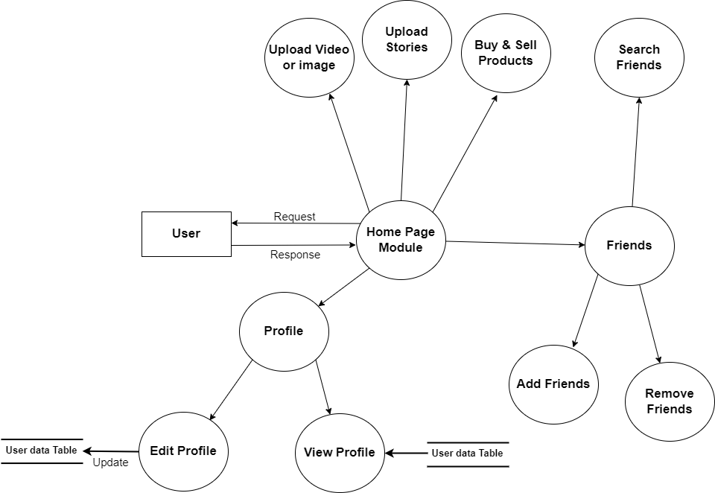
Triibe Design
Level 2 Data Flow Diagram (Home Page):

Slide 31
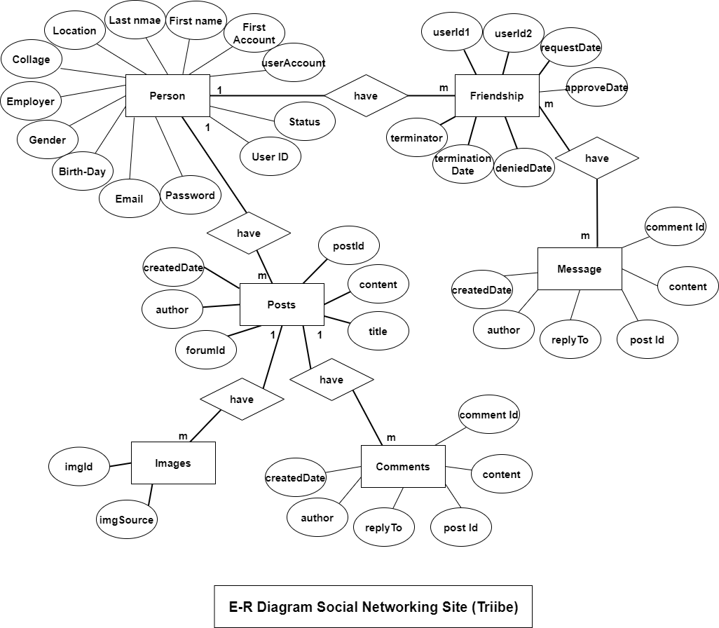
Triibe Design
ER Diagram:

Slide 32
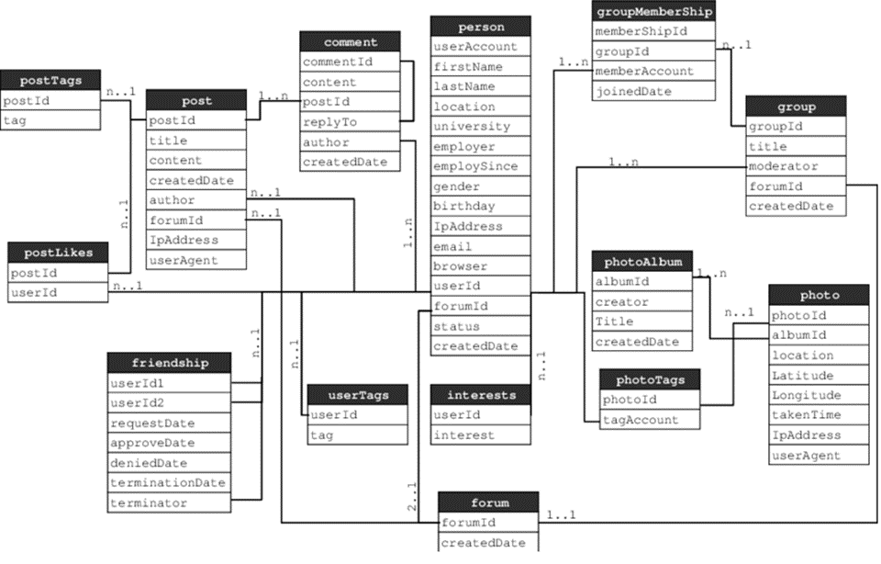
Triibe Design
Database Schema:

Slide 33
Programming Languages Used in this project:
HTML: a globally recognized markup language for Producing web pages.
CSS: a markup language that takes care of the styling of the web page.
JavaScript: a scripting language that takes care of the page behavior.
PHP: a general-purpose scripting language geared toward web development.
jQuery (AJAX): Ajax is a set of web development techniques that uses various web technologies on the client-side to create asynchronous web applications.
SQL: a standardized programming language that is used to manage relational databases and perform various operations on the data in them.

Slide 34
Testing
06

Slide 35
Black & White Box Testing
Black Box Testing: The technique of testing in which the tester doesn’t have access to the source code of the software and is conducted at the software interface without concern with the internal logical structure of the software is known as black-box testing.
White Box Testing: The technique of testing in which the tester is aware of the internal workings of the product has access to its source code and is conducted by making sure that all internal operations are performed according to the specifications is known as white box testing.
Grey box Testing: a combination of both White Box and Black Box Testing.

Slide 36
Login Page Testing
Test Case # | Test Case Description | Test Data | Expected Results | Actual Result | Pass/Fail
1 | Check the response when valid student number and password are entered | StdNo: 120180612122 Password: Admin123 | Login should be successful | Login was successful | Pass
2 | Check the response when valid student number and invalid password are entered | StdNo: 120180612122 Password: admin123 | Popup should appear to tell the user he entered an invalid information | Popup Appeared And the login was unsuccessful | Pass
3 | Check the response when invalid student number and invalid password are entered | StdNo: 120180612 Password: admin123 | Popup should appear to tell the user he entered an invalid information | Popup Appeared And the login was unsuccessful | Pass
4 | Check the response when no information is entered | StdNo: Password: | Popup should appear to tell the user to enter his information | Popup Appeared And the login was unsuccessful | Pass

Slide 37
07
Conclusion

Slide 38
Conclusion
Triibe main goal wasn’t for generating profit from universities but was to make a private platform that helps students communicate with each other more easily, for this project, we employed the waterfall approach, which is a sequential development process that flows like a waterfall through all phases of a project, The project's analysis and design stages were then finished. which included the main design diagrams such as the DFD sequence diagram, use-case diagram, context diagram, and so on. Then the project was implemented using the PHP programming language Finally, this project was evaluated using white-box and black-box testing approaches.

Slide 39
Limitations
Some students have some difficulties using social media websites.
Difficulties to verify every post that is posted on the platform.
Some students are hesitant to use social media platforms because of their lack of trust.
Social media websites use huge amounts of data, which can be difficult to handle by the university's integrated servers.
Some students refuse to use platforms other than those they are already familiar with.

Slide 40
Future Works
The main future approach for this project is to build an all-in-one platform for students so they don’t have to use many platforms.
A list of Future works:
Live Audio and video calls and meetings.
Add a range of payment methods for the market page.
Further enhance the security of the website.
Add artificial Intelligence for detecting and reporting spam and unappropriated content on the website.

Slide 41
Appreciation
Many people have contributed to the success of this work. We'd like to express our gratitude to everyone who contributed to this effort.
First and foremost, we thank God for allowing us to successfully accomplish this project. Then we appreciate Prof. Dr. Malek Alksasbeh, our supervisor, for his recommendations and direction in completing this study.
Finally, we'd want to express our gratitude to the parents and friends who assisted us with excellent advice and recommendations at various phases of the project.
Thank you …

Slide 42
05
Implementation

Slide 43
Triibe
Implementation

